Slide 1
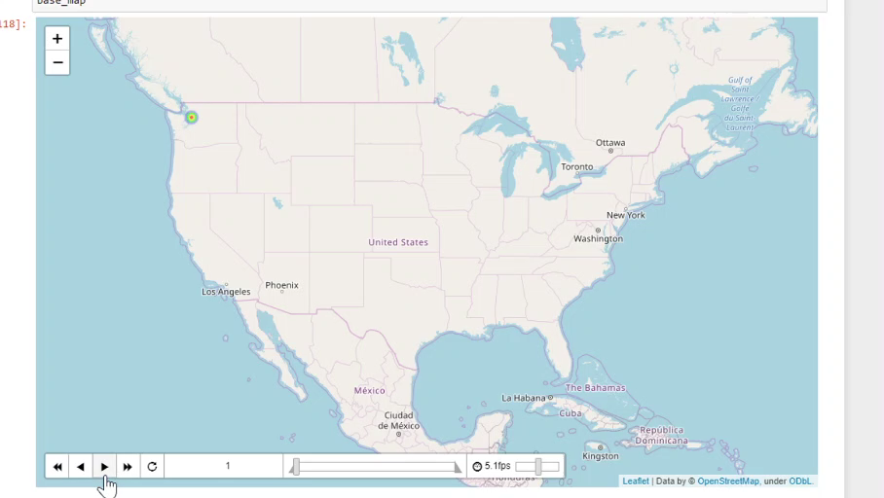
Predicting and Visualizing the Spread of COVID-19
IBM Data Science CourseEra Capstone Project
Michael Lynch

Slide 2
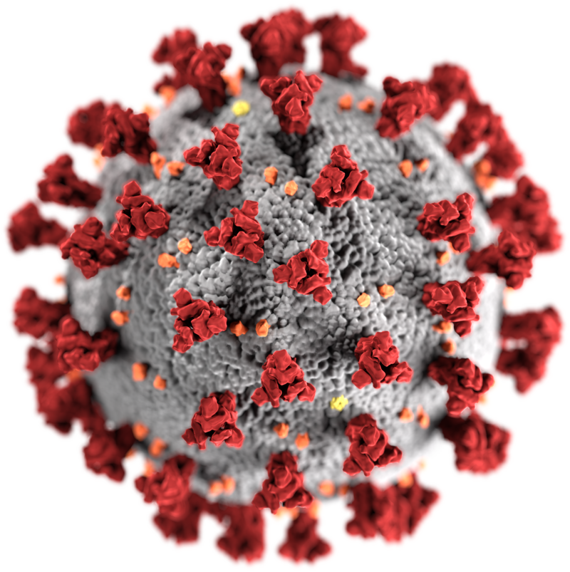
Introduction
A novel coronavirus, COVID-19, was first reported in Wuhan, China in December 2019
As of April 2020 (present) the virus has spread globally and is classified by the World Health Organization as a pandemic
It is important for data scientists to analyze data from COVID-19 in order to inform political leaders

Slide 3
Introduction
In this presentation I will:
Show you visualizations of the spread of COVID-19 over the US
Show you the machine learning predicted increase in cases yet to come
Discuss what we should expect in the near future

Slide 4
Data
Three datasets used
https://www.covidtracking.com
John Hopkins’ GitHub: https://github.com/CSSEGISandData/COVID-19
NYTimes’ GitHub: https://github.com/nytimes/covid-19-data

Slide 5
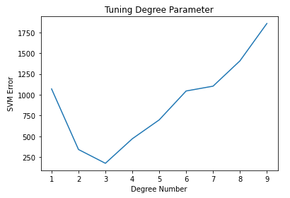
Methodology
SVM Used for predicting increase in number of cases for all states in the US
Used scikit-learn SVR function
Hyperparameters were tuned for the state of MN (big assumption, I know!)
Hyperparameters chosen, shrinking=False, kernel=‘Poly’, gamma=0.01, epsilon=0.01, degree=3, C=1

Slide 6
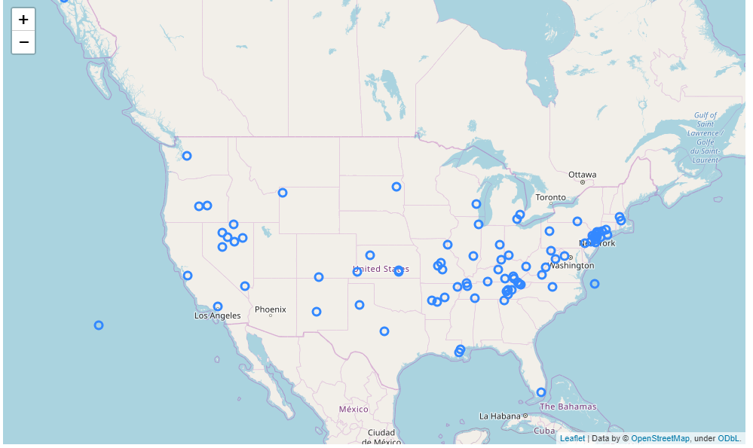
Methodology
K-means clustering used to find clusters of areas high in cases of COVID-19

Slide 7
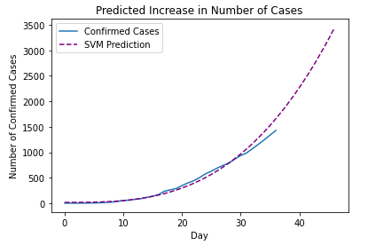
Results for MN
The SVM fit is pretty good
Starts to deviate from the fit at higher day numbers

Slide 8
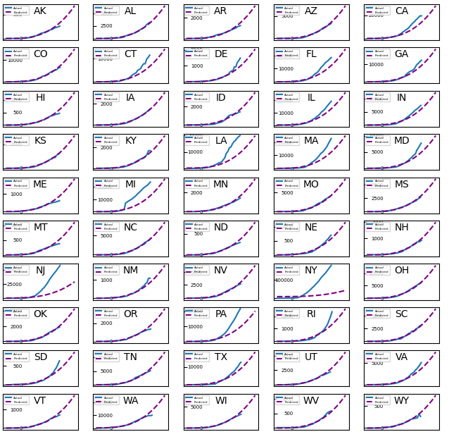
Results for all states
Comparison of increase in number of cases for each state
It appears some states are doing better than others

Slide 9
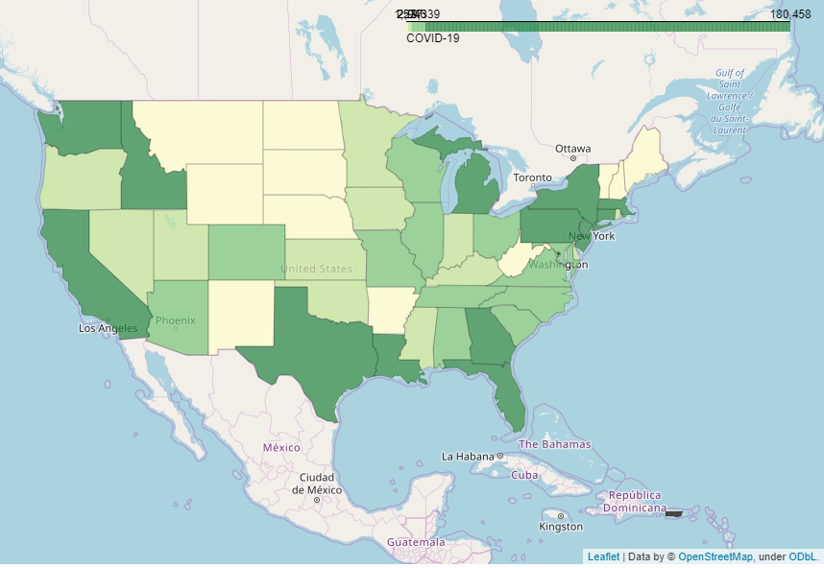
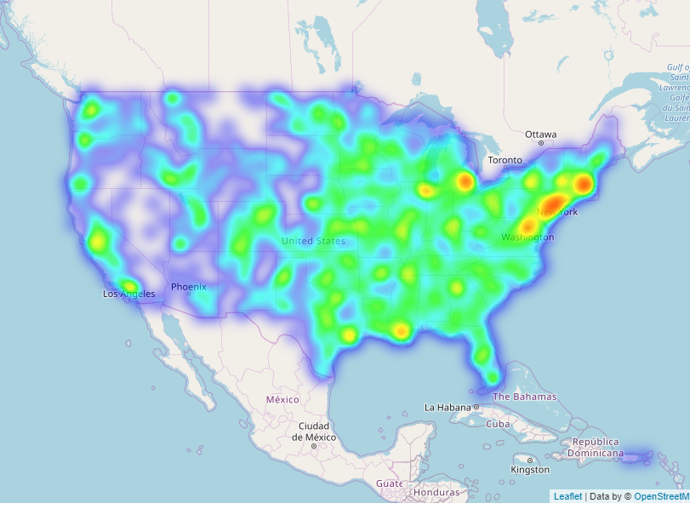
Results: Comparing Different Maps
Choropleth
K-means cluster centers
Heatmap

Slide 10
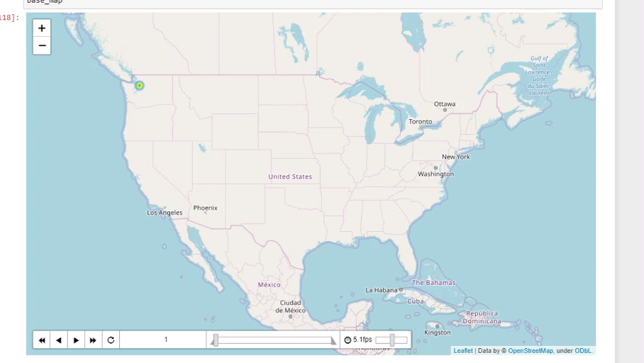
Results: Heatmap with Time

Slide 11
Conclusion
The number of cases will continue to increase for the near future (~weeks to months)
Nowhere is safe from the virus
Wash sands and stay 6 feet away!

